Slide 1


Spacecraft!
The care and keeping of a legacy application
With illustrations by
catalystvibes.dribbble.com

Slide 2

Annie Lydens
Jenny Allar
Notes:
Hi, I’m Annie, I’m a developer at Initialized Capital, where I work on software that powers investment operations.
Hi, I’m Jenny. I’m a developer at Guild Education. We partner with large organizations like Disney, Pepsi, and Walmart to provide education as a benefit for their employees. Jenny and I have worked together and

Slide 3


Notes:
apart on several different legacy codebases, and despite how people typically describe software as “architecture”, which feels shiny and perfect and new, we’ve grown to think about legacy applications as spaceships – hunks of metal hurling through the sky, with people inside working hard to keep the thing on course.

Slide 4

Notes:
So today, we’re going to talk about the care [CLICK] -and keeping of your legacy spaceships at home, and we’re going to do that by telling you an allegory.

Slide 5


CHAPTER 1
DESPAIR
Notes:
Chapter One - Despair

Slide 6


Yuki
Legacy
Notes:
In a galaxy not very far away, there lives an [CLICK] astronaut named Yuki. Yuki lives aboard the [CLICK] spaceship Legacy with his team.
Most days are good - the team works together to complete missions sent to them by mission control, and the spaceship has served them well for a long time.

Slide 7

Notes:
But Yuki can’t help but notice that missions are taking longer to complete.
The ship, which once felt clean, tidy, and modern, has grown almost unrecognizable.[CLICK] - The ship has strange knobs and tubes, the creation of which predated Yuki’s time on the ship, and nobody seems to know what they’re for.

Slide 8
Notes:
The exterior of the ship has been patched with one-off fixes,

Slide 9



Notes:
and the interior of the ship [CLICK ] is crowded with baggage from team members new and old.

Slide 10
WARNING:
Your ship is outdated/buggy. Please upgrade.
Finished in 51.97 seconds (files took 17.53 seconds to load)
938 examples, 291 failures
Notes:
The ship’s manuals are outdated, [CLICK ] and the team’s diagnostic tests are slow, painful to run, and not comprehensive. The diagnostic tests take so long that the team has started running them more rarely, and avoids adding more.
There is even a whole section of the ship built by a former coworker, who went on a spacewalk one day and never came back

Slide 11

uh oh
Notes:
Yuki doesn’t go to that part of the ship anymore - it’s too confusing over there, and the last time anyone tried to do anything in there, the ship wasn’t operable for two days. [CLICK ]
With the state of the ship, missions are taking longer and longer. Yuki hasn’t been able to take a vacation in months. Mission Control is starting to lose faith in the team’s ability to deliver. The situation feels untenable.

Slide 12

CHAPTER 2
THE
BLACK HOLE
Notes:
Chapter Two - The Black Hole

Slide 13


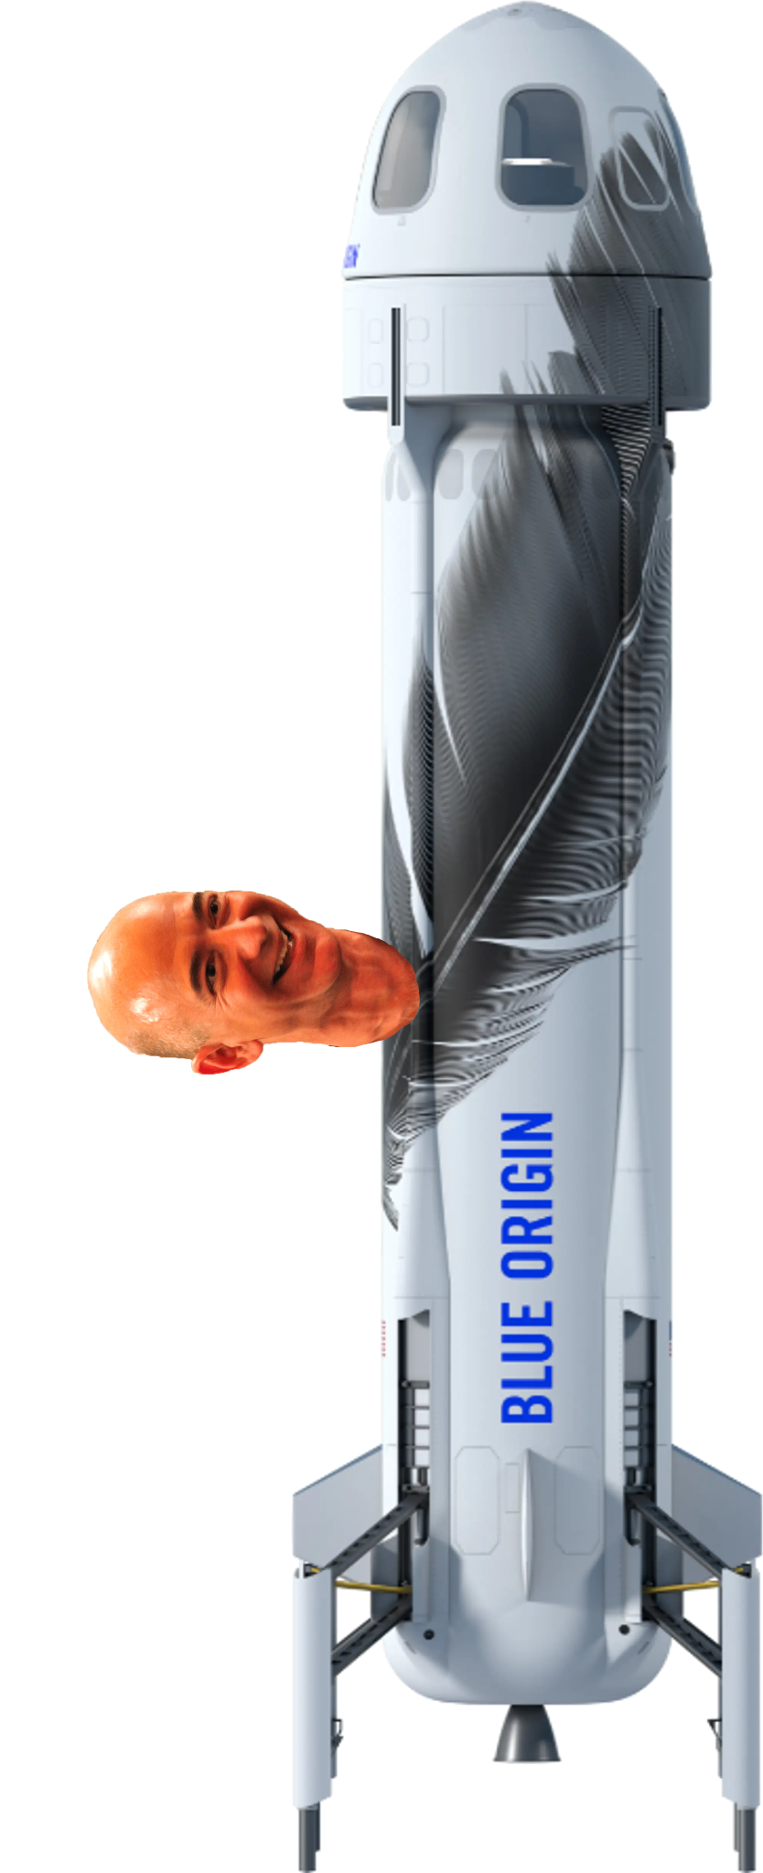
Notes:
In times like these, it’s easy to look out the window of your ship and daydream.
Frustrated by the ship one day, Yuki looks outside [CLICK] and sees a nice spaceship flying by, and wonders [CLICK] wistfully if they have cold brew on tap over there.
Then Yuki spots something else - a black hole. [CLICK]
Yuki has heard of black holes, but it is the first time the team on the Legacy had gotten close enough to feel its enticing, gravitational pull.
The black hole is the promise of a full rewrite.

Slide 14

this is fine
Notes:
Yuki has heard of other lead astronauts who drove their ships into the black hole.
Sometimes it worked, he’s heard, when executed nimbly [CLICK] in the right context.

Slide 15


Notes:
With the state of the ship, Yuki feels the [CLICK] pull of the black hole.
What if they threw the spaceship out? They could start from scratch [CLICK] –
build enough bedrooms for everyone -
fix their launchers – get rid of the mysterious cruft gathered on the ship’s surface.

Slide 16
Notes:
But Yuki also knows that the siren song of the black hole disguises the dangers within. If they went that route, it would be easy to leave the team in a much worse state.
They had already lost trust with ground control, and going into the black hole would make that worse. To ground control, it would look like they were standing still, not making any progress, even if Yuki communicated with them the best he could.
Even worse, their competitor’s ships were always just a few seconds behind - pausing or hindering forward progress would mean that their competitor’s spaceships [CLICK] would zoom right past. If the ship being a mess is the only reason you want to sign your team up for a full rewrite, it’s probably not the right choice.

Slide 17

Notes:
Yuki pulls his eyes away from the glimmer of the black hole, and considers his ship [CLICK] once more.
He decides: it’s time to do something.

Slide 18

CHAPTER 3
ASSESSMENT
Notes:
CHAPTER 3, ASSESSMENT To get anywhere, you have to know where you’re starting from.

Slide 19



Notes:
Yuki fires up the Communicator and calls [CLICK] - Amanda, a principal astronaut he’s worked with before, and explains the situation. She asks him first about the diagnostic tests.[CLICK]
“We have some tests”, Yuki says,”but they’re slow, and some of them are flaky, and there are large portions of the ship that are missing coverage”.
“There are no shortcuts here, “ Amanda says. ”You need a test suite running reliably to make progress on improving your ship.”

Slide 20

Notes:
“We have such limited time, though”, Yuki laments. “We’re already behind. We don’t have time to backfill a bunch of missing tests, and everything’s a mess - it’s hard to tell what to work on first.”

Slide 21




Mission: Assess & Benchmark
Identify Code:test ratio
Identify Code coverage
Notes:
“You’re not alone in this problem, Yuki”, Amanda says. “But you also can’t tackle this all at once. You’ll want to assess and benchmark your ship to find the areas that are best worth your attention.
[CLICK] “This assessment can start with the basics”, Amanda says. “To judge the state of the diagnostic test suite and track progress over time, you’ll want to have a general idea of your code-to-test ratio and test coverage.”

Slide 22
Mission: Assess & Benchmark
Identify Code:test ratio
Identify Code coverage
Notes:
“This isn’t about an absolute measurement”, Amanda says.
“Rather, it helps you judge where you are starting from, and know whether your efforts are moving the ship in the right direction.”
There are lots of different tools that can help assess the starting point, but two easy options for Yuki are `rails stats` and the `simplecov` gem.

Slide 23
rails stats
➜ rails stats
| Name | Lines | LOC | Classes | Methods |
| Controllers | 6803 | 6311 | 54 …
| Models | 9600 | 6959 | 82 …
…
| Total | 21737 | 20664 | 156 | 🚨
Code LOC: 18006 Test LOC: 3658 Code:Test Ratio: 1:0.2
Notes:
rails stats is built into Rails, and is useful for getting general summary information about an application.
When run, rails stats outputs a summary table that includes lines of code, number of methods, number of classes, and so on. The final line includes a number that we can use as a gut-check on the relationship between our lines of code and our tests. This isn’t the best tool or the only tool for this, but it is a quick, convenient way to get a sense of the code-to-test ratio.

Slide 24
rails stats
➜ rails stats
| Name | Lines | LOC | Classes | Methods |
| Controllers | 6803 | 6311 | 54 …
| Models | 9600 | 6959 | 82 …
…
| Total | 21737 | 20664 | 156 | 🚨
Code LOC: 18006 Test LOC: 3658 Code:Test Ratio: 1:0.2
Notes:
It’s important to note that this metric isn’t telling us how well our tests are exercising our code or the quality of our tests, so it’s a limited insight, but it is one high-level signpost amongst several that Yuki can use to gauge his ship.
He notices the code-to-test ratio is one to point two - the team will want to get that closer to 1:1.

Slide 25
simplecov
All Files (36.2% covered at 0.73 hits/line)
File | % covered | Avg. Hits / Line
app/models/astronaut.rb | 6.67 % | 0.07
app/services/flux_launcher.rb | 18.18 % | 0.18
app/controllers/api/v1/asteroids_controller.rb | 18.40 % | 0.18
app/controllers/api/v1/missions_controller.rb | 18.57 % | 0.19
app/controllers/api/v1/users_controller.rb | 20.00 % | 0.20
app/services/message_parser.rb | 22.22 % | 0.22
app/controllers/api/v1/meteors_controller.rb | 24.11 % | 0.24
app/models/alien.rb | 24.11 % | 0.24
Notes:
Simplecov is a coverage analysis tool that comes with some nice reports and visualizations of coverage, down to specific methods and lines of code. Simplecov will do its best to detect which lines of code were executed when the test suite ran.
100% coverage as reported by simplecov doesn’t mean you have a perfect test suite, but it’s a way to benchmark your coverage and understand where it is lacking with a pretty nice level of detail.
These tools can give Yuki an overall sense of the diagnostic testing starting point and the characteristics of the ship.

Slide 26



Notes:
SLIDE 24 -Yuki and Amanda talk for a while, and Yuki comes away with a plan to improve the diagnostic test coverage, step by step. [CLICK]
First, the team will prioritize fixing the flaky diagnostic tests.
In addition to being annoying, the flaky tests have diminished the team’s overall confidence in the test suite. It’s been hard to tell what’s a flaky test and what’s a real failure.
It’s been hard to build upon an untrustworthy foundation.

Slide 27



Oh yes, quite flaky
Notes:
SLIDE 25 - Yuki and the team will need to pin down exactly which tests in [CLICK] the current suite are flaky.
The team will prioritize making time to address the flaky tests, so they have high confidence in the coverage that exists today, even if that coverage is less robust than they’d like.
Then, the team can start to think about optimizing the existing tests so that the suite is faster and less frustrating to run.

Slide 28
Improve existing suite: identify slowest tests
➜ bundle exec rspec --profile
Top 10 slowest examples (39.0% of total time):
./spec/services/turbo_launcher_spec.rb:34
./spec/models/astronaut_spec.rb:106
./spec/models/space_food_spec.rb:13
…
Notes:
There are lots of methods of attack, but Yuki has decided to start by identifying the 10 slowest tests and diagnosing the source of the bottlenecks.
Often, the 10 slowest tests in a suite will represent a hefty chunk of the overall test suite time, giving Yuki an opportunity to find low hanging fruit to prioritize.
By finding the slowest tests in the suite, Yuki can understand whether certain tests are taking disproportionate amounts of time to run.
This can be a great way to identify opportunities for immediate performance improvements.

Slide 29

Identify high churn and high complexity
skunk
flog
churn
Code Climate
Notes:
SLIDE 27 - After optimizing existing tests, Yuki can then start looking forward, and find the best areas to incrementally add high-value tests.
To find critical areas for coverage, Yuki will focus on two techniques.
First, he’ll use a tool like Skunk, Flog, Churn or Code Climate to identify areas of high complexity and high churn.

Slide 30
Identify high churn and high complexity
Most complicated and changes most often
Churn
Prioritize test coverage and refactoring time here
Complexity
Notes:
SLIDE 28 -Churn is a measure of change in a system over time. More change, higher churn.
Areas with high complexity are harder to understand, to work with, and to change.
Complicated things changing often are important things to test, and can be good targets for refactoring opportunities.

Slide 31





Notes:
Next, he’ll talk [CLICK] to his team, including [CLICK] mission control and those in [CLICK] support roles . Working together, they will map the most critical paths, and they will use this information to determine how much of the most important behavior on the ship is untested.
The mission-critical areas and the areas of high churn and complexity will be their team’s consistent focus: these are

Slide 32

Toasty
Notes:
the hotspots in the codebase.
Hot spots are the areas that represent great return-on-investment. Work also tends to concentrate in hot spots.

Slide 33

Make peace with an incremental approach
Notes:
If the team can commit to writing tests that support their day-to-day work, over time, coverage will be added to hotspots naturally and incrementally and these high value areas can be improved.
The team doesn’t have a mandate or a pressing reason to march off and fix everything. They’ll need to work with mission control to address the most critical paths when they can, but the larger changes will happen slowly over time.
The team will need to make peace with an incremental approach.

Slide 34

CHAPTER 4
PARTS UNKNOWN
Notes:
SLIDE 32- CHAPTER 4: PARTS UNKNOWN

Slide 35

Notes:
SLIDE 33 - After talking it out with Amanda, Yuki is feeling better about making improvements in the parts of the ship that the crew is familiar with. But he can’t help but think about the other, more mysterious parts.

Slide 36




Notes:
SLIDE 34- That dark corner with all those modules [CLICK], long overlooked…
Those components [CLICK] that Carol attached to the ship before she went on her spacewalk and never came back….
How does the team start improving the stuff that they don’t understand?
Carol is long gone, and Yuki’s not sure who left that dark corner in its current state. These parts of the ship are missing institutional knowledge, and without it, how can the team figure out what to do?

Slide 37
Notes:
Yuki decides SLIDE 35- that he’ll separate the unknown parts of the ship into important SLIDE 36 - and not-important SLIDE 37 - parts, and he’ll invest his time in the SLIDE 38- former.

Slide 38
Important
Not Important
Notes:
Yuki decides SLIDE 35- that he’ll separate the unknown parts of the ship into important SLIDE 36 - and not-important SLIDE 37 - parts, and he’ll invest his time in the SLIDE 38- former.

Slide 39
Important
Not Important
Notes:
Yuki decides SLIDE 35- that he’ll separate the unknown parts of the ship into important SLIDE 36 - and not-important SLIDE 37 - parts, and he’ll invest his time in the SLIDE 38- former.

Slide 40
Important
Not Important
Notes:
Yuki decides SLIDE 35- that he’ll separate the unknown parts of the ship into important SLIDE 36 - and not-important SLIDE 37 - parts, and he’ll invest his time in the SLIDE 38- former.

Slide 41

=> Booting Puma
=> Rails 6.0.3.1 application starting in development
=> Run `rails server --help` for more startup options
[56522] Puma starting in cluster mode...
[56522] * Version 4.3.5 (ruby 2.7.1-p83), codename: Mysterious Traveller
[56522] * Min threads: 5, max threads: 5
[56522] * Environment: development
[56522] * Process workers: 2
[56522] * Phased restart available
[56522] * Listening on tcp://127.0.0.1:3004
[56522] * Listening on tcp://[::1]:3004
[56522] Use Ctrl-C to stop
[56522] - Worker 0 (pid: 56624) booted, phase: 0
[56522] - Worker 1 (pid: 56625) booted, phase: 0
[56522] ! Terminating timed out worker: 56624
[56522] ! Terminating timed out worker: 56625
[56522] ! Out-of-sync worker list, no 56625 worker
[56522] ! Out-of-sync worker list, no 56624 worker
[56522] - Worker 0 (pid: 82900) booted, phase: 0
[56522] - Worker 1 (pid: 82901) booted, phase: 0
[56522] ! Terminating timed out worker: 82900
[56522] - Worker 0 (pid: 95986) booted, phase: 0
[56522] ! Terminating timed out worker: 82901
[56522] - Worker 1 (pid: 17605) booted, phase: 0
[56522] ! Terminating timed out worker: 95986
[56522] - Worker 0 (pid: 17835) booted, phase: 0
[56522] ! Terminating timed out worker: 17605
[56522] ! Terminating timed out worker: 17835
[56522] ! Out-of-sync worker list, no 17835 worker
[56522] - Worker 0 (pid: 17956) booted, phase: 0
[56522] - Worker 1 (pid: 17957) booted, phase: 0
[56522] ! Terminating timed out worker: 17956
[56522] ! Terminating timed out worker: 17957
[56522] ! Out-of-sync worker list, no 17956 worker
[56522] ! Out-of-sync worker list, no 17957 worker
[56522] - Worker 0 (pid: 18084) booted, phase: 0
[56522] - Worker 1 (pid: 18085) booted, phase: 0
[56522] ! Terminating timed out worker: 18084
[56522] ! Terminating timed out worker: 18085
[56522] ! Out-of-sync worker list, no 18084 worker
[56522] ! Out-of-sync worker list, no 18085 worker
[56522] - Worker 0 (pid: 18218) booted, phase: 0
[56522] - Worker 1 (pid: 18219) booted, phase: 0
[56522] ! Terminating timed out worker: 18218
[56522] ! Terminating timed out worker: 18219
[56522] ! Out-of-sync worker list, no 18218 worker
[56522] ! Out-of-sync worker list, no 18219 worker
[56522] - Worker 0 (pid: 18386) booted, phase: 0
[56522] - Worker 1 (pid: 18387) booted, phase: 0
[56522] ! Terminating timed out worker: 18386
[56522] ! Terminating timed out worker: 18387
[56522] - Worker 0 (pid: 18509) booted, phase: 0
[56522] - Worker 1 (pid: 18510) booted, phase: 0
[56522] ! Terminating timed out worker: 18509
[56522] ! Terminating timed out worker: 18510
[56522] ! Out-of-sync worker list, no 18509 worker
[56522] ! Out-of-sync worker list, no 18510 worker
[56522] - Worker 0 (pid: 18634) booted, phase: 0
[56522] - Worker 1 (pid: 18635) booted, phase: 0
[56522] ! Terminating timed out worker: 18634
[56522] ! Terminating timed out worker: 18635
[56522] ! Out-of-sync worker list, no 18634 worker
[56522] - Worker 0 (pid: 18765) booted, phase: 0
[56522] - Worker 1 (pid: 18766) booted, phase: 0
[56522] ! Terminating timed out worker: 18765
[56522] ! Terminating timed out worker: 18766
[56522] ! Out-of-sync worker list, no 18765 worker
[56522] ! Out-of-sync worker list, no 18766 worker
[56522] - Worker 0 (pid: 18884) booted, phase: 0
[56522] - Worker 1 (pid: 18885) booted, phase: 0
[56522] ! Terminating timed out worker: 18884
[56522] ! Terminating timed out worker: 18885
[56522] ! Out-of-sync worker list, no 18884 worker
[56522] ! Out-of-sync worker list, no 18885 worker
[56522] - Worker 0 (pid: 19026) booted, phase: 0
[56522] - Worker 1 (pid: 19027) booted, phase: 0
[56522] ! Terminating timed out worker: 19026
[56522] ! Terminating timed out worker: 19027
[56522] ! Out-of-sync worker list, no 19026 worker
[56522] ! Out-of-sync worker list, no 19027 worker
[56522] - Worker 0 (pid: 19362) booted, phase: 0
[56522] - Worker 1 (pid: 19363) booted, phase: 0
[56522] ! Terminating timed out worker: 19363
[56522] - Worker 1 (pid: 25608) booted, phase: 0
[56522] ! Terminating timed out worker: 25608
[56522] - Worker 1 (pid: 36494) booted, phase: 0
[56522] ! Terminating timed out worker: 36494
[56522] - Worker 1 (pid: 62910) booted, phase: 0
[56522] ! Terminating timed out worker: 19362
[56522] - Worker 0 (pid: 63044) booted, phase: 0
[56522] ! Terminating timed out worker: 62910
[56522] ! Terminating timed out worker: 63044
[56522] ! Out-of-sync worker list, no 63044 worker
[56522] - Worker 1 (pid: 63271) booted, phase: 0
[56522] - Worker 0 (pid: 63270) booted, phase: 0
[56522] ! Terminating timed out worker: 63270
[56522] ! Terminating timed out worker: 63271
[56522] ! Out-of-sync worker list, no 63270 worker
[56522] - Worker 1 (pid: 63454) booted, phase: 0
[56522] - Worker 0 (pid: 63453) booted, phase: 0
[56522] ! Terminating timed out worker: 63453
[56522] ! Terminating timed out worker: 63454
[56522] ! Out-of-sync worker list, no 63453 worker
[56522] ! Out-of-sync worker list, no 63454 worker
[56522] - Worker 0 (pid: 63605) booted, phase: 0
[56522] - Worker 1 (pid: 63606) booted, phase: 0
[56522] ! Terminating timed out worker: 63605
[56522] ! Terminating timed out worker: 63606
[56522] ! Out-of-sync worker list, no 63605 worker
[56522] ! Out-of-sync worker list, no 63606 worker
[56522] - Worker 1 (pid: 45772) booted, phase: 0
[56522] - Worker 0 (pid: 45771) booted, phase: 0
[56522] ! Terminating timed out worker: 45771
[56522] ! Terminating timed out worker: 45772
[56522] ! Out-of-sync worker list, no 45771 worker
[56522] ! Out-of-sync worker list, no 45772 worker
[56522] - Worker 0 (pid: 45850) booted, phase: 0
[56522] - Worker 1 (pid: 45851) booted, phase: 0
[56522] ! Terminating timed out worker: 45850
[56522] ! Terminating timed out worker: 45851
[56522] ! Out-of-sync worker list, no 45851 worker
[56522] ! Out-of-sync worker list, no 45850 worker
[56522] - Worker 1 (pid: 48098) booted, phase: 0
[56522] - Worker 0 (pid: 48097) booted, phase: 0
[56522] ! Terminating timed out worker: 48098
[56522] - Worker 1 (pid: 59649) booted, phase: 0
[56522] ! Terminating timed out worker: 48097
[56522] ! Terminating timed out worker: 59649
[56522] ! Out-of-sync worker list, no 48097 worker
[56522] ! Out-of-sync worker list, no 59649 worker
[56522] - Worker 0 (pid: 59672) booted, phase: 0
[56522] - Worker 1 (pid: 59673) booted, phase: 0
[56522] ! Terminating timed out worker: 59672
[56522] ! Terminating timed out worker: 59673
[56522] ! Out-of-sync worker list, no 59672 worker
[56522] ! Out-of-sync worker list, no 59673 worker
[56522] - Worker 1 (pid: 59815) booted, phase: 0
[56522] - Worker 0 (pid: 59814) booted, phase: 0
[56522] ! Terminating timed out worker: 59814
[56522] ! Terminating timed out worker: 59815
[56522] ! Out-of-sync worker list, no 59814 worker
[56522] ! Out-of-sync worker list, no 59815 worker
[56522] - Worker 1 (pid: 59909) booted, phase: 0
[56522] - Worker 0 (pid: 59908) booted, phase: 0
[56522] ! Terminating timed out worker: 59908
[56522] ! Terminating timed out worker: 59909
[56522] ! Out-of-sync worker list, no 59909 worker
[56522] ! Out-of-sync worker list, no 59908 worker
[56522] - Worker 1 (pid: 60408) booted, phase: 0
[56522] - Worker 0 (pid: 60407) booted, phase: 0
[56522] ! Terminating timed out worker: 60407
[56522] ! Terminating timed out worker: 60408
[56522] ! Out-of-sync worker list, no 60407 worker
[56522] ! Out-of-sync worker list, no 60408 worker
[56522] - Worker 0 (pid: 60459) booted, phase: 0
[56522] - Worker 1 (pid: 60460) booted, phase: 0
[56522] ! Terminating timed out worker: 60459
[56522] ! Terminating timed out worker: 60460
[56522] ! Out-of-sync worker list, no 60460 worker
[56522] ! Out-of-sync worker list, no 60459 worker
[56522] - Worker 1 (pid: 40157) booted, phase: 0
[56522] - Worker 0 (pid: 40156) booted, phase: 0
[56522] ! Terminating timed out worker: 40157
[56522] ! Out-of-sync worker list, no 40157 worker
[56522] - Worker 1 (pid: 43057) booted, phase: 0
^C[56522] - Gracefully shutting down workers...
[56522] === puma shutdown: 2022-05-05 20:10:30 -0600 ===
[56522] - Goodbye!
Exiting
[20:10:30] jennyallar:guild-legacy git:(tagging-resources*) $ rails s
=> Booting Puma
=> Rails 6.0.3.1 application starting in development
=> Run `rails server --help` for more startup options
[44865] Puma starting in cluster mode...
[44865] * Version 4.3.5 (ruby 2.7.1-p83), codename: Mysterious Traveller
[44865] * Min threads: 5, max threads: 5
[44865] * Environment: development
[44865] * Process workers: 2
[44865] * Phased restart available
[44865] * Listening on tcp://127.0.0.1:3004
[44865] * Listening on tcp://[::1]:3004
[44865] Use Ctrl-C to stop
[44865] - Worker 0 (pid: 44910) booted, phase: 0
[44865] - Worker 1 (pid: 44911) booted, phase: 0
source=rack-timeout id=cc2fbd3f-df03-48cf-98d2-3b422e6abc9b timeout=15000ms state=ready
source=rack-timeout id=cc2fbd3f-df03-48cf-98d2-3b422e6abc9b timeout=15000ms service=3ms state=active
Started POST "/graphql" for ::1 at 2022-05-05 20:10:57 -0600
(8.5ms) SELECT "schema_migrations"."version" FROM "schema_migrations" ORDER BY "schema_migrations"."version" ASC
Processing by GraphqlController#execute as */*
Parameters: {"query"=>"mutation updateSpaceBlasters($input: UpdateSpaceBlastersPayload!) {\n updateSpaceBlasters(input: $input) {\n name\n stripeAccount\n }\n}", "variables"=>{"input"=>{"name"=>"Alamo Colleges District", "stripeAccount"=>"acct_1HoFWfPW3mQsWPO7"}}, "graphql"=>{"query"=>"mutation updateSpaceBlasters($input: UpdateSpaceBlastersPayload!) {\n updateSpaceBlasters(input: $input) {\n name\n stripeAccount\n }\n}", "variables"=>{"input"=>{"name"=>"Alamo Colleges District", "stripeAccount"=>"acct_1HoFWfPW3mQsWPO7"}}}}
source=rack-timeout id=cc2fbd3f-df03-48cf-98d2-3b422e6abc9b timeout=15000ms service=1004ms state=active
Filter chain halted as :authenticate_request! rendered or redirected
Completed 401 Unauthorized in 960ms (Views: 1.1ms | ActiveRecord: 0.0ms | Allocations: 2483)
source=rack-timeout id=cc2fbd3f-df03-48cf-98d2-3b422e6abc9b timeout=15000ms service=1673ms state=completed
source=rack-timeout id=f5e165ce-f550-40ac-b6aa-8674236dedb1 timeout=15000ms state=ready
source=rack-timeout id=f5e165ce-f550-40ac-b6aa-8674236dedb1 timeout=15000ms service=1ms state=active
Started POST "/graphql" for ::1 at 2022-05-05 20:11:10 -0600
Processing by GraphqlController#execute as */*
Parameters: {"query"=>"query {\n academicPartnerInvoicesReport {\n id\n invoiceNumber\n status\n dateReceived\n createdAt\n }\n }", "graphql"=>{"query"=>"query {\n academicPartnerInvoicesReport {\n id\n invoiceNumber\n status\n dateReceived\n createdAt\n }\n }"}}
Filter chain halted as :authenticate_request! rendered or redirected
Completed 401 Unauthorized in 0ms (Views: 0.1ms | ActiveRecord: 0.0ms | Allocations: 135)
source=rack-timeout id=f5e165ce-f550-40ac-b6aa-8674236dedb1 timeout=15000ms service=4ms state=completed
source=rack-timeout id=41fec33c-a27e-4b07-892d-760a06767ad9 timeout=15000ms state=ready
source=rack-timeout id=41fec33c-a27e-4b07-892d-760a06767ad9 timeout=15000ms service=1ms state=active
Started POST "/graphql" for ::1 at 2022-05-05 20:11:22 -0600
Processing by GraphqlController#execute as */*
Parameters: {"query"=>" query {\n applications(studentId: \"28db5e96-4fcc-44f6-afc1-503f4f65297d\") {\n id\n state {\n name\n }\n termStartDate\n termEndDate\n }\n }", "graphql"=>{"query"=>" query {\n applications(studentId: \"28db5e96-4fcc-44f6-afc1-503f4f65297d\") {\n id\n state {\n name\n }\n termStartDate\n termEndDate\n }\n }"}}
Filter chain halted as :authenticate_request! rendered or redirected
Completed 401 Unauthorized in 0ms (Views: 0.1ms | ActiveRecord: 0.0ms | Allocations: 135)
source=rack-timeout id=41fec33c-a27e-4b07-892d-760a06767ad9 timeout=15000ms service=4ms state=completed
source=rack-timeout id=e9738956-f09d-4708-b048-38af5e6ed15a timeout=15000ms state=ready
source=rack-timeout id=e9738956-f09d-4708-b048-38af5e6ed15a timeout=15000ms service=2ms state=active
Started POST "/graphql" for ::1 at 2022-05-05 20:12:51 -0600
Processing by GraphqlController#execute as */*
Parameters: {"query"=>" query {\n applications(studentId: \"28db5e96-4fcc-44f6-afc1-503f4f65297d\") {\n id\n state {\n name\n }\n termStartDate\n termEndDate\n }\n }", "graphql"=>{"query"=>" query {\n applications(studentId: \"28db5e96-4fcc-44f6-afc1-503f4f65297d\") {\n id\n state {\n name\n }\n termStartDate\n termEndDate\n }\n }"}}
Completed 200 OK in 347ms (Views: 0.7ms | ActiveRecord: 0.0ms | Allocations: 62401)
source=rack-timeout id=e9738956-f09d-4708-b048-38af5e6ed15a timeout=15000ms service=374ms state=completed
Notes:
SLIDE 39 - Though no one knows exactly how Carol’s components work, by checking the logs, [CLICK] Yuki’s also certain that only a small handful of people have ever used them, and they seem completely inactive today.
They were last touched 3 years ago, and don’t seem to be used in the ship.
He puts the components in the not-important category.
They are confusing, hard to maintain, and not central to the ship’s mission.
He’ll confirm their status with mission control, and work on a plan to remove them altogether.

Slide 42
Complexity must earn its keep
Notes:
Complexity must earn its keep, and these old components are hardly doing that.

Slide 43

?
Notes:
SLIDE 40 - He’s less sure about the pile of modules in the dark corner of the ship.
He can see that they appear to be referenced in lots of places, but it’s not clear what they do or why they are there.
This is where things feel a lot hairier. Yuki doesn’t want to accidentally collapse a part of the ship – there are people inside, including himself, and that would make for a truly terrible Monday.

Slide 44
?
Notes:
Yuki is going to have to be much more cautious with these parts.
They’re clearly important, but it’s worrisome that no one knows how they work. Even if they can pretend these parts don't exist today, there’s going to be a day where that’s no longer the case. The team will need to face the unknown head-on.

Slide 45

CHAPTER 5
RECOVERING INSTITUTIONAL KNOWLEDGE
Notes:
Chapter Five - Recovering Institutional Knowledge

Slide 46



Notes:
Yuki grabs a [CLICK] notepad, [CLICK] his boba tea, and a flashlight. He’s anxious yet ready to investigate the unknown areas of the ship. There’s a real fear that touching any of the mysterious modules could launch the ship off track at any moment.

Slide 47

Notes:
As Yuki steps farther into the space, [CLICK] he sees a window. It’s just a small, unassuming port-hole sized window, but he wonders how it might be useful.

Slide 48

Notes:
He opens it, sticks his head out and shouts into the universe “HELLO?” and “DOES ANYONE KNOW WHAT THIS THING DOES?”
He’s hoping an astronaut that worked on this craft in the past might hear him and have some knowledge or context to share. Not a soul answers him. It was worth a shot but sometimes you are the last link in the chain.
Yuki pulls his head back in and looks around for clues.

Slide 49

Mission: Gather context
Chronological journey:
Who worked on this?
When did they work on it?
Why was it done?
Intention of code
Trade-offs and constraints
Notes:
To recover institutional knowledge about this part of the ship, Yuki will need to pull together any information he can. Ideally, he’ll be able to gather context, intentions, and tradeoffs that impacted the way the past astronauts built this section.
Yuki digs into the Chronological journey of this area by asking:
Who worked on this?
When was this work done?
Why was it necessary?
What was the intention of code?
What were the trade-offs and constraints for this project?

Slide 50
Mission: Gather context
Chronological journey:
Who worked on this?
When did they work on it?
Why was it done?
Intention of code
Trade-offs and constraints
Notes:
To find the answers to these questions, the team can reference git history, pull requests, old tickets, and any other artifacts that exist for the work.
Context can also be gathered through improving the team’s high-level understanding of the system.
Yuki thinks it might be helpful for the astronauts and the lovely folks from Mission Control to get an overview of what entities and relationships exist within the Legacy today.

Slide 51
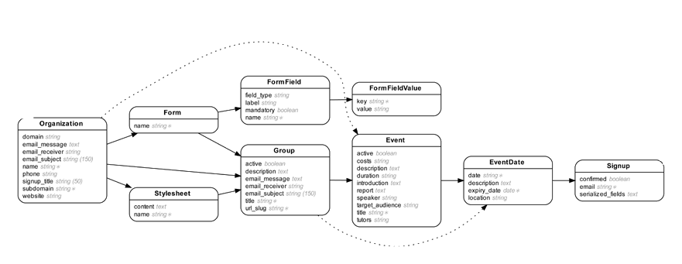
$ bundle exec erd
Loading application in 'ss-legacy’...
Generating entity-relationship diagram…
Warning: Ignoring invalid models…
Diagram saved to 'erd.pdf'.
rails-erd
Notes:
Yuki turns to the rails-erd for this. This ruby gem uses ActiveRecord to generate a diagram of how each model relates to others. He proudly hangs this diagram up in the team room. This will serve as a sort of map for the team and get them all using the same domain language around each entity. They’ve been using the term ‘rocket’ and ‘booster’ interchangeably, so this should clear some things up.

Slide 52
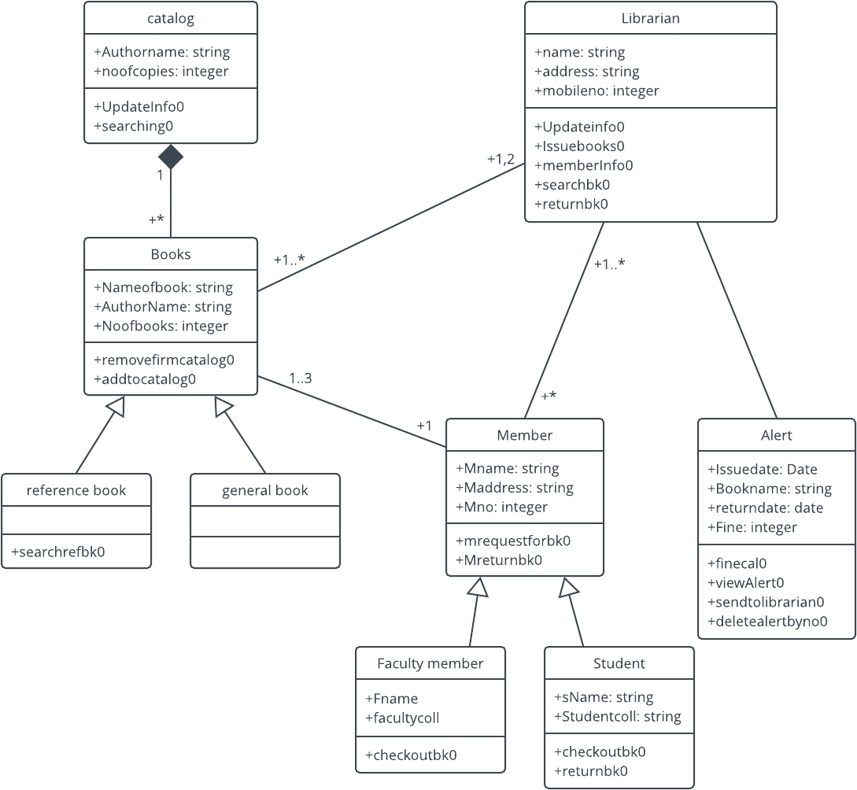


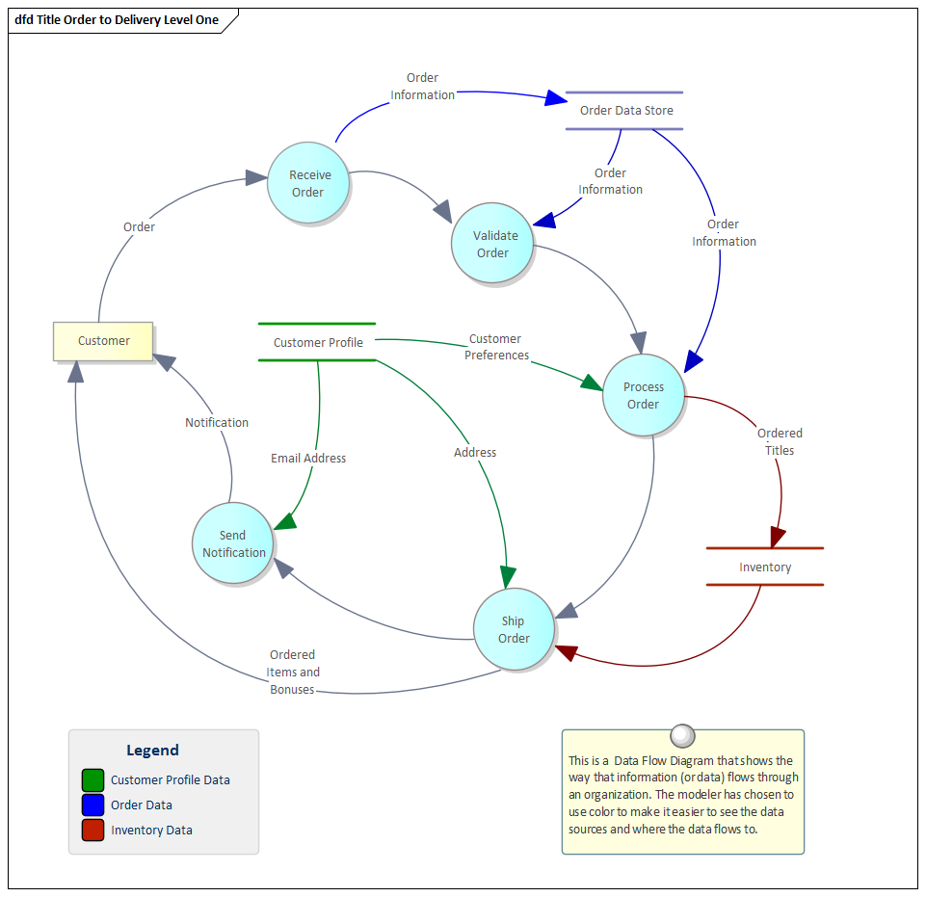





Notes:
Yuki imagines the entire room papered in diagrams, maps, and documents outlining common practices for the astronauts on board. He thinks this could be really useful for the next spaceperson they onboard to help them build a solid foundation and hit the ground running.
Next to this new map, Yuki hangs up a sign-up sheet for the team to volunteer to add to these crucial resources. He encourages each astronaut on board to take ownership of even a small piece of the Legacy. If each member of the team can become a domain expert in section of the ship, Yuki hopes the sense of ownership and responsibility can be spread more evenly.

Slide 53

Notes:
It’s easy to encounter older, frustrating code, and face it with judgment, but code is not written in a vacuum:

Slide 54
Software is the product of the context in which it was produced.
Notes:
it is the product of the context in which it was produced.
Patterns or decisions that were in vogue then might be outdated today.
Constraints that existed then might not exist now.
Understanding that context, the backstory of how the code came to be, gives you an enormous leg up in understanding how something works today.

Slide 55

SOCIALIZING KNOWLEDGE
CHAPTER 6

Slide 56

Notes:
SLIDE 50 - In Yuki's quest to recover institutional knowledge about the most confusing parts of the ship, he realizes that he needs to relay his findings to the team as soon as possible, and find a permanent place for this information to live in case he ever takes a spacewalk of his own.

Slide 57
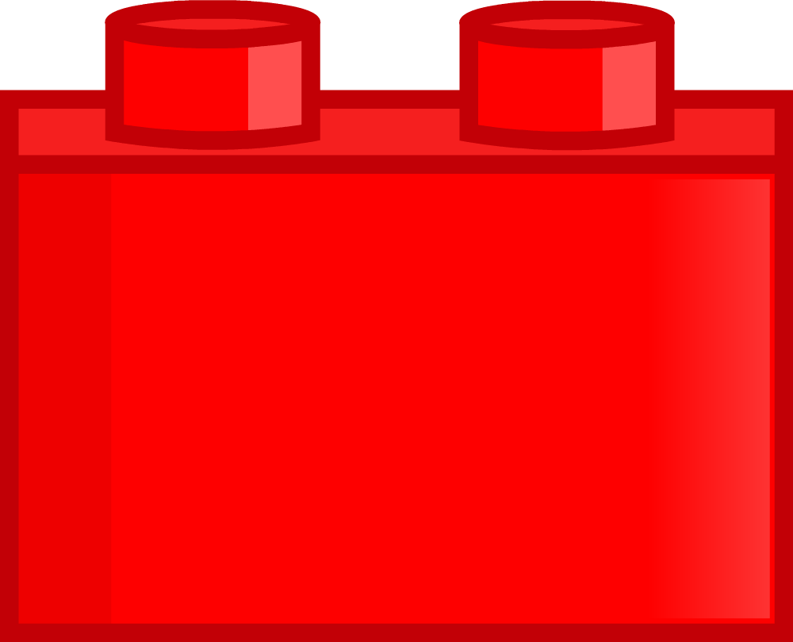
Notes:
SLIDE 51 - He wants to ensure that future astronauts [CLICK] can build on his work, rather than repeat it.
It’s his responsibility to organize this information and use it to help inform the team’s decisions going forward.

Slide 58
Socializing the “why”
y?
Notes:
SLIDE 52 -The biggest thing, Yuki realizes, is that to make progress on the ship, they are going to have to treat documentation efforts as first-class work. They need to be capturing more of the *why* behind the work they are doing, and they need to make a better effort to share that knowledge with each other.

Slide 59
Socializing the “why”
Pair programming
Tests
Demos
Architecture decision records
Commit messages that include the “why”
Commit: 7d45fh569584406946f07958
Author: Yuki <yuki@spaceperson.net>
Set blasters to 11
Previously, we had blasters set to 10. This was causing intermittent failures for the Borgatron.
Borgatron v2 needs blasters > 10 to fully engage.
Notes:
Socializing this information can happen in lots of different formats:
Pairing, tests, demos, architecture decision records, and even in commit messages that better capture the “why” behind work being done

Slide 60

Socializing the “why”
Why is this important to share?
When is it needed?
How often will it change?
How will we know to update it?
y
Notes:
To avoid a bunch of documentation being captured in a wiki and then left behind, Yuki gets his team together to discuss what context they need to capture, and when and how it should be shared or updated.
They ask:
Why and When is this information important to share?
How often will it change?
When will we know that it needs an update?

Slide 61
Socializing the “why”
Why is this important to share?
When is it needed?
How often will it change?
How will we know to update it?
y
Notes:
For the bulk of the documentation, when changes are needed, it should be obvious (for example, like with a failing test), or happen naturally as a part of the work (like with a new commit message).
Yuki and the team will need to distinguish between documentation that is likely need to change often, and documentation that will need updates less frequently, and choose the best format for each.

Slide 62

Notes:
The goal is to arrive at a balanced approach where the whole team has more context behind the work being done,
documentation is readily accessible
And when it needs to change, it’s a natural part of the team’s workflow.
If documentation had been better preserved in the past, Yuki’s journey to recover institutional knowledge would be much easier - or not needed at all.

Slide 63

CHAPTER 7
WORKING AS A TEAM

Slide 64
Notes:
Yuki takes a slow, thoughtful walk and finds himself again staring out the window of the ship. He’s not admiring other ships or gazing into the black hole; this time he sees his own reflection in the window. He’s spent so much time lately digging through cosmic particles, documenting, and jotting down ideas on how to make the ship better, but he hasn’t taken the time to figure out how the ship got to this point.

Slide 65
Notes:
And how can Yuki ensure it doesn’t happen again? The happiness of his teammates is important now more than ever and he’s committed to retaining his crew on this special spacecraft.
An application’s success or failure is rarely determined by solely the lead engineer. Legacy systems evolve and lapse on their own naturally once deprioritized enough. Yuki’s job now is to make sure the right folks are on board to prioritize the care and improvement of the Legacy.

Slide 66


Notes:
With this in mind, Yuki decides a check-in with Mission Control is long overdue. He quickly [CLICK] shoots off a message to the General [CLICK] inviting anyone interested to attend the daily stand-up meeting with all of the astronauts. This should keep the entire crew on the same page, create a sense of confidence between business units again and eventually provide a quick-feedback cycle for everyone involved. This meeting can also serve as a good place for Mission Control to ask questions to help them better plan and prioritize the commitments on deck for Yuki and team.

Slide 67



Notes:
Yuki gets the team together to establish some new team agreements.
Working agreements describe the way the team wants to work together. These ground rules could be an entire living document or simply a few spoken guidelines. Regardless- team agreements establish rules, or behaviors that define the way the team best collaborates.

Slide 68


Notes:
Not everyone has been on the same radio frequency when it comes to getting code out and it’s important they all acknowledge the ground rules for any kind of deployment.
[CLICK] If there are any problems or failing tests, they agree to power down the engines until things can be patched. The team decides that a minimum of two astronauts should give a thumbs up before the boosters are engaged. And lastly, the team has committed to adding to the test suite with any new code on deck.

Slide 69
Notes:
[CLICK] Yuki and the team had previously agreed to have retrospectives, but they haven’t had one in a while - other things kept coming up. They revisit this agreement, and Yuki draws a large red heart on the 15th of each month of the calendar so the team re-commits to regular retros. It will be a chance for the astronauts and Mission Control to reflect on what’s gone well and what could have been better. Yuki’s had success with this process in the past and knows the value of building trust among all facets of the enterprise.
The team agreements established here and the time spent adhering to them will be a valuable long term investment for the Legacy. From experience, Yuki, knows that these will have a positive impact on the team’s productivity, distribution of responsibility, and keeping each other accountable.

Slide 70
CHAPTER 8
SUM OF ALL PARTS

Slide 71
Notes:
So if you’re like Yuki, you might find yourself staring out the window of your ship, or overwhelmed at the work left behind by previous astronauts.

Slide 72

Notes:
You might feel stuck.
The work ahead will be hard but rewarding. This work is different than new feature development, but it’s important. Some might call it “keeping the lights on”, but it’s more than that.
This work is the care and keeping of legacy applications. This work is code stewardship.

Slide 73
Notes:
SLIDE 62 -It’s a team commitment to incrementally tidy,
to improve, [CLICK]
to define and adhere to standards,
to trust in each other and in Mission Control,
and to shepherd the codebase and shared knowledge through the dark unknown.

Slide 74

Yuki’s code stewardship:
Weighed a rewrite
Committed to incremental improvement
Assessed the codebase to get a baseline
Identified areas of high churn & high complexity
Explored mysterious areas of the codebase
Recovered and socialized institutional knowledge
Set intentional team agreements
Notes:
In Yuki’s case, he:
Weighed a rewrite
- committed to incremental improvement
He assessed the codebase, getting baseline benchmarks to understand where the team was starting from
He Identified areas of high churn & high complexity
He explored the lesser known areas of the ship to recover lost institutional knowledge, and he shared that knowledge with others
And he set intentional team agreements so that the team can move forward together in their commitment to incremental improvement.

Slide 75


Notes:
-Over time, the team will understand more about how their spaceship operates, and will have prioritized meaningful efforts to make it better.
New astronauts will find it easier to join the ship.
Steadily, trust with mission control can be rebuilt.
The Legacy will be an operable and enjoyable hunk of metal flying through space for many lightyears to come.

Slide 76

Notes:
And after many years of dreaming, Yuki will get his cold brew on tap.

Slide 77

THANK YOU!
Annie Lydens
Jenny Allar
@aelydens
@JennyAllar
Notes:
Thank you all for attending and joining us on this journey.
Please come talk to us about your own Legacy tales!

